Slide 1
Big Mountain Resort
Data Driven Ticket Pricing

Slide 2
Central Issue
Big Mountain has been charging a premium above the average price of resorts in its market segment.
But what if the resort is not capitalizing on its facilities to the fullest potential?
How important are some facilities/features of a resort compared to others?
Could Big Mountain raise its ticket price?
With existing features or with certain improvements…
Or could Big Mountain lower operating costs?

Slide 3
Ticket Price Increase Supported
Current ticket underpriced compared to other resorts with similar features
Modeling indicates Big Mountain can increase ticket price to about $95
Other cost-saving and/or feature enhancing (with corresponding ticket price hike) changes can be considered
$81
$95
Without resort modifications

Slide 4
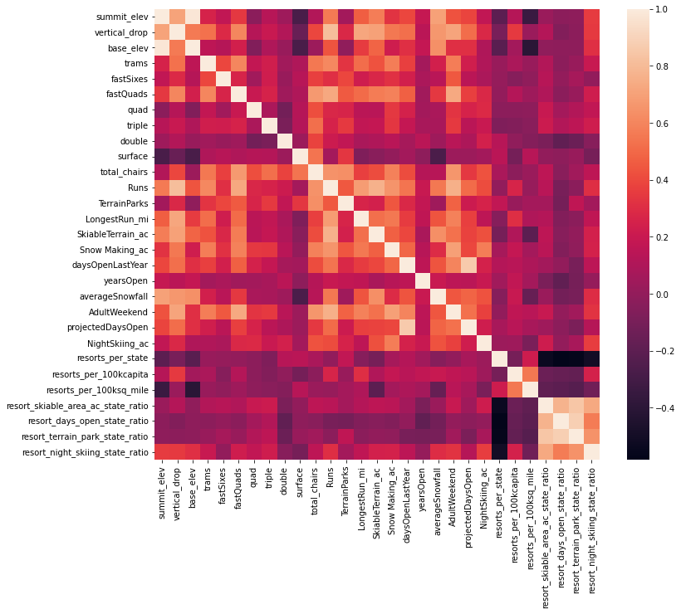
Heat Map of correlations between ski resort features
White = strong positive correlation
Reddish-purple = zero correlation
Black = moderate negative correlation

Slide 5
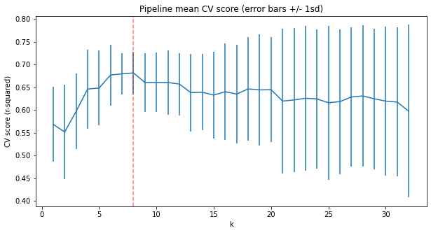
Linear Regression
The cross-validation score is highest when the model uses the top eight features

Slide 6
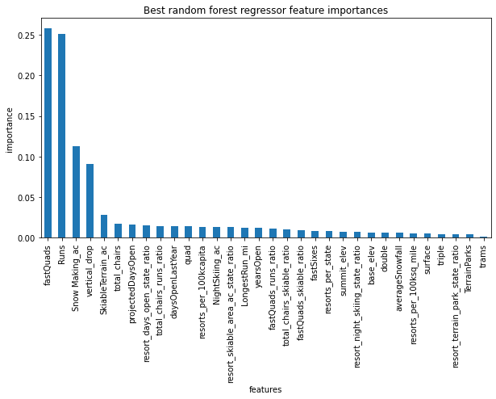
Random Forest Regressor
The top 4 most important features in the random forest model align with the top 4 from the linear model

Slide 7
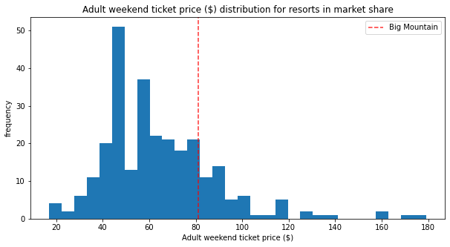
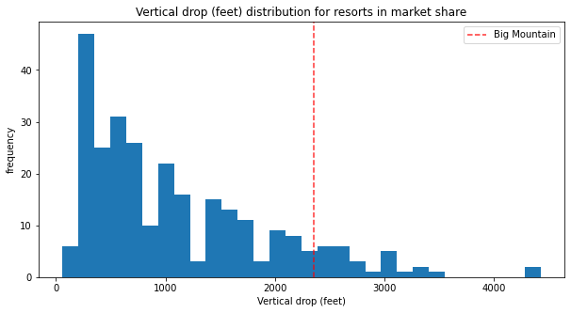
Summary and Conclusion
Very reasonable to charge ~$4-16 more per ticket because Big Mountain is undervalued based on the modeled price for the features of the resort.
Big Mountain is toward the high end on all important features (like vertical drop, snow making, fast quads, total runs, total chairs, longest run, skiable acreage.
One scenario of capital improvement could support a higher ticket price (installing a new lift to add a run that would increase total vertical drop)
Another scenario could close up to 5 runs to decrease operating costs but would lead to a drop in modeled ticket price

